Slide 1

22년 삼성 AI 전문가과정
6월 8일 수요일 4교시
장병탁
인공지능
13차시 : Utility-Based Agents
서울대학교 컴퓨터공학부
담당 교수: 장병탁
Seoul National University
Byoung-Tak Zhang

Slide 2
Lecture Overview
인공지능
13차시 : Utility-Based Agents
서울대학교 컴퓨터공학부
담당 교수: 장병탁
Seoul National University
Byoung-Tak Zhang

Slide 3
Introduction
Temporal Reasoning (Previous lecture)
We use probability theory to quantify the degree of belief in elements of the belief state
We define basic inference tasks and describes the general structure of inference algorithms for temporal models
→ hidden Markov models, Kalman filters, dynamic Bayesian networks
Utility-Based Agents (This lecture)
We examine methods for deciding what to do today, given that we may face another decision tomorrow
We are concerned here with sequential decision problems, in which the agent’s utility depends on a sequence of decisions
Sequential decision problems incorporate utilities, uncertainty, and sensing, and include search and planning problems as special cases
We consider the algorithms for MDPs, and the algorithms for solving POMDPs

Slide 4
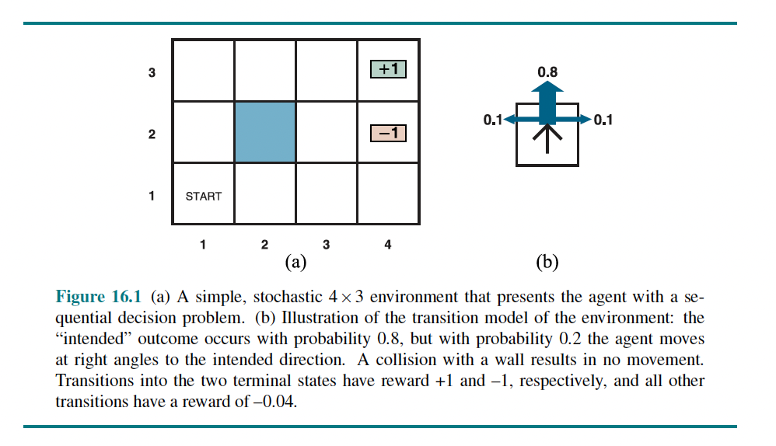
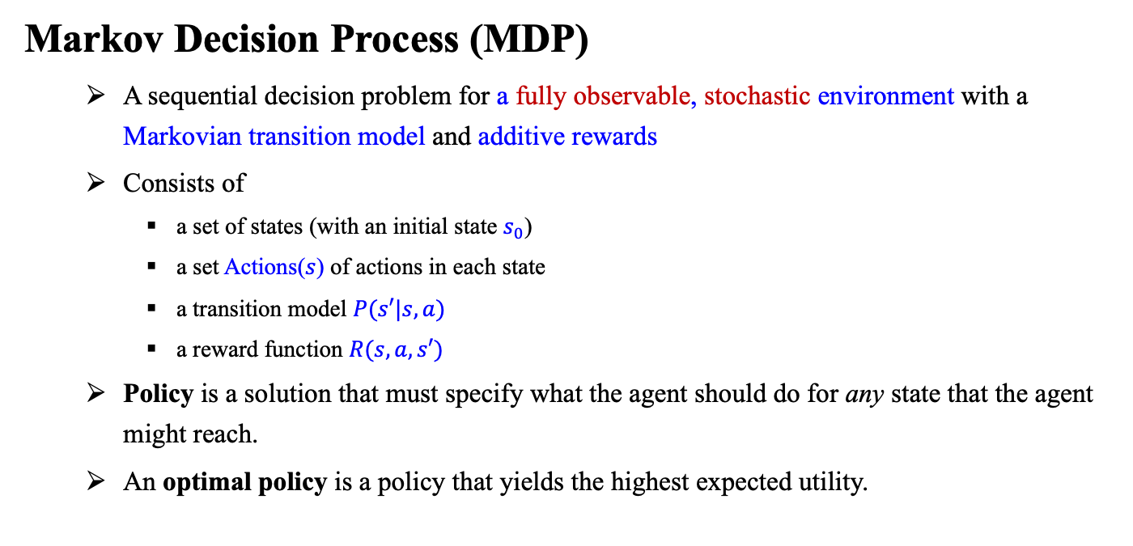
Sequential Decision Problems
Markov Decision Process (MDP)
A sequential decision problem for a fully observable, stochastic environment with a Markovian transition model and additive rewards
Consists of
a set of states (with an initial state $s_{0}$)
a set Actions($s$) of actions in each state
a transition model $P(s′|s, a)$
a reward function $R(s,a,s′)$
Policy is a solution that must specify what the agent should do for any state that the agent might reach.
An optimal policy is a policy that yields the highest expected utility.

Slide 5
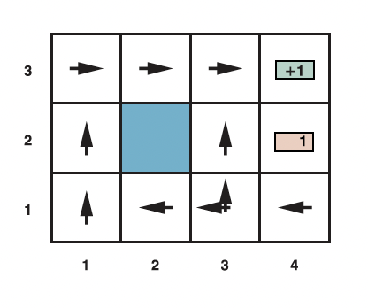
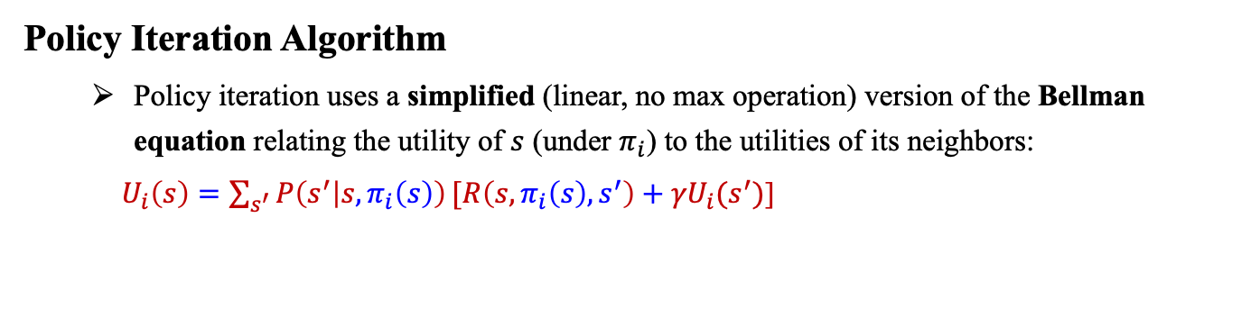
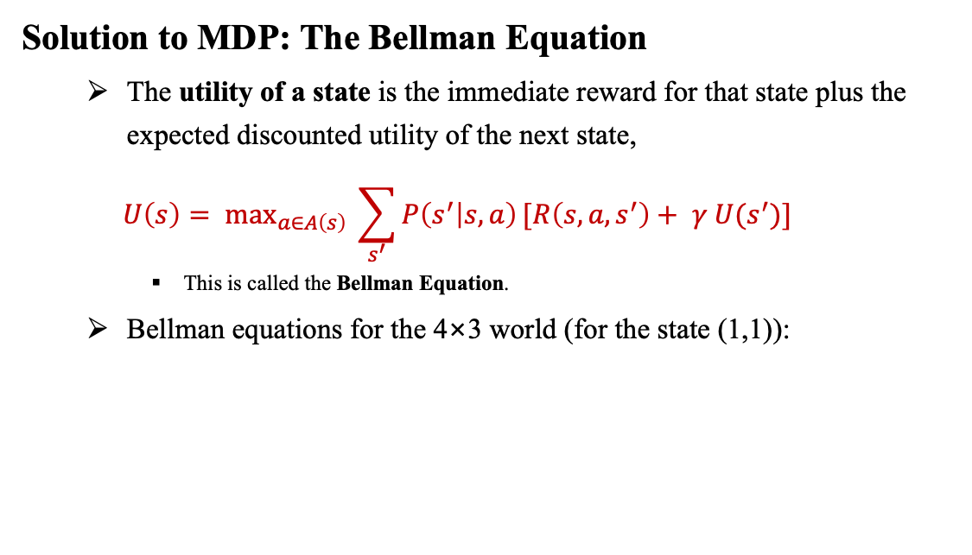

Solutions to MDPs
Solution to MDP: The Bellman Equation
The utility of a state is the immediate reward for that state plus the expected discounted utility of the next state,
$$U\left(s\right)= \text{ma}{\text{x}}_{a∈A\left(s\right)} \sum_{s^{′}}{P\left(s^{′} | s, a\right)}[R\left(s,a,s^{′}\right)+ γ U(s^{′})]$$
This is called the Bellman Equation.
Bellman equations for the 4×3 world (for the state (1,1)):
<출처> Stuart J. Russell and Peter Norvig (2021). Artificial Intelligence: A Modern Approach (4th Edition). Pearson
Policy Iteration Algorithm
Policy iteration uses a simplified (linear, no max operation) version of the Bellman equation relating the utility of $s$ (under $π_{i}$) to the utilities of its neighbors:
$U_{i}\left(s\right)=\sum_{s^{′}}{P\left(s^{′} | s, π_{i}\left(s\right)\right)}{[R\left(s,π_{i}\left(s\right), s^{′}\right)+γU}_{i}(s^{′})$]

Slide 6
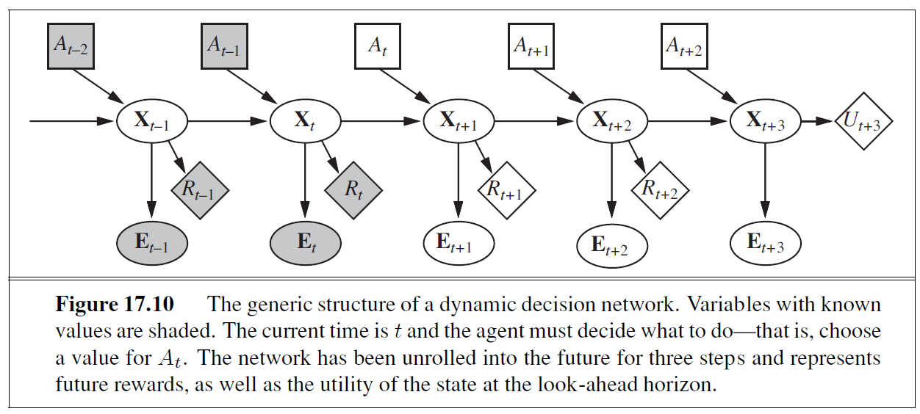
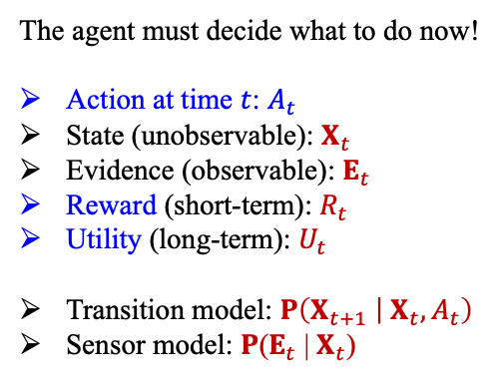
Partially Observable MDP (POMDP)
Partially Observable Markov Decision Process (POMDP)
The agent must decide what to do now!
Action at time $t$: $A_{t}$
State (unobservable): $X_{t}$
Evidence (observable): $E_{t}$
Reward (short-term): $R_{t}$
Utility (long-term): $U_{t}$
Transition model: $P\left(X_{t+1} | { X}_{t},A_{t}\right)$
Sensor model: $P\text{(}E_{t} \text{|}{ X}_{t}\text{)}$
<출처> Stuart J. Russell and Peter Norvig (2021). Artificial Intelligence: A Modern Approach (4th Edition). Pearson

Slide 7
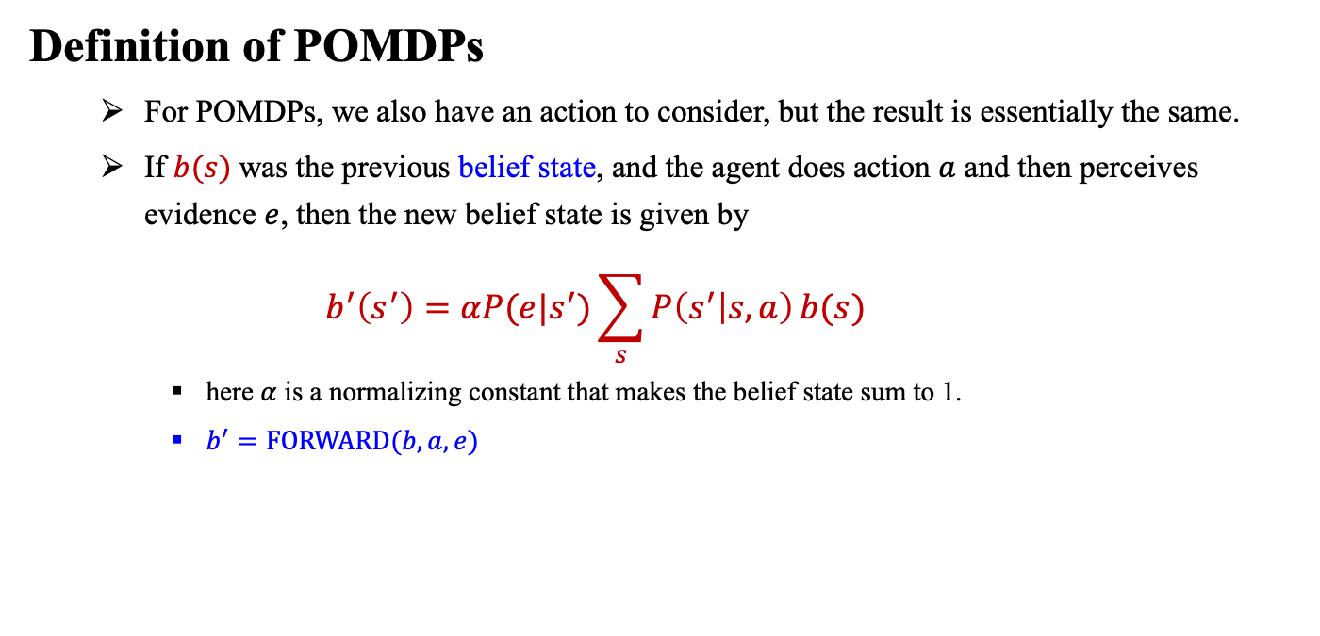
Partially Observable MDPs
Definition of POMDPs
For POMDPs, we also have an action to consider, but the result is essentially the same.
If $b(s)$was the previous belief state, and the agent does action $a$ and then perceives evidence $e$, then the new belief state is given by
$$b^{′}\left(s^{′}\right)=αP(e|s^{′})\sum_{s}{P\left(s^{′} | s, a\right)}b(s)$$
here $α$ is a normalizing constant that makes the belief state sum to 1.
$b^{′}=\text{FORWARD}(b, a, e)$

Slide 8
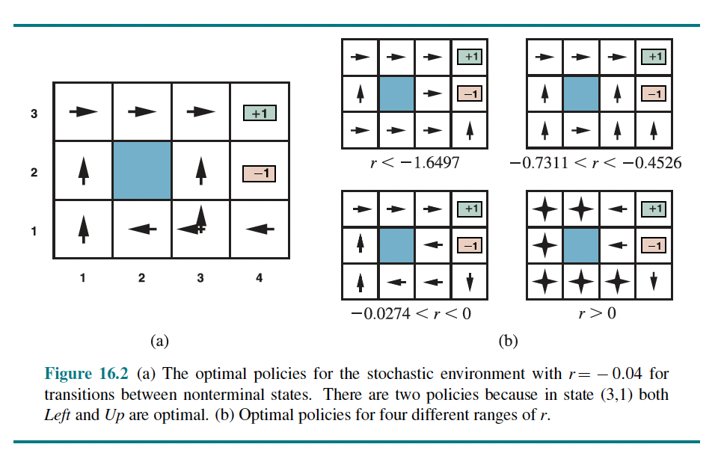
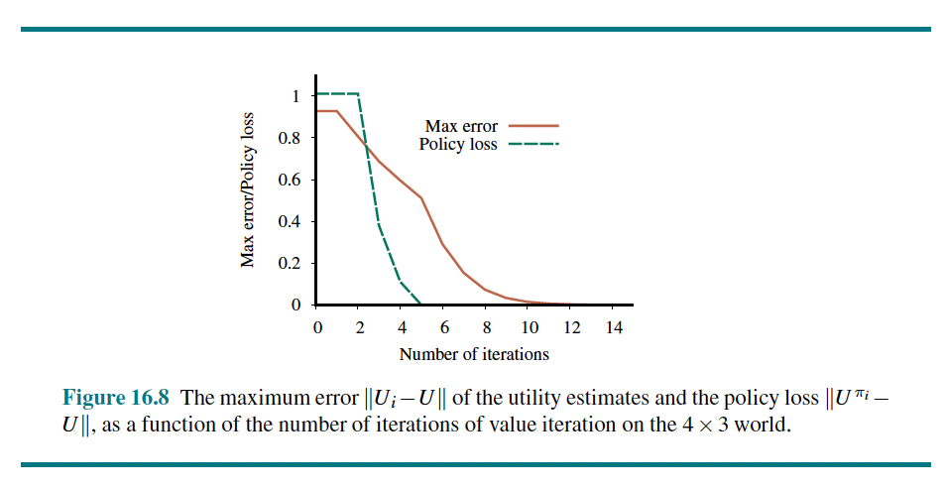
Lecture 13. Utility-Based Agents
Sequential Decision Problems
Utility function, MDP, POMDP
Algorithms for MDPs
Value Iteration, Policy Iteration
Finding optimal policies: Bellman equations
Partially Observable MDPs
Decision-theoretic agents, Definition of POMDPs
Algorithms for Solving POMDPs
Value Iteration for POMDPS
Dynamic decision networks = dynamic Bayesian net + decision net
<출처> Stuart J. Russell and Peter Norvig (2021). Artificial Intelligence: A Modern Approach (4th Edition). Pearson

Slide 9
Outline (Lecture 13)
13.1 Sequential Decision Problems …………………
13.2 Algorithms for MDPs ………………………….
13.3 Partially Observable MDPs ……………………
13.4 Algorithms for Solving POMDPs ……………
Summary ……………………………………………
10
18
30
36
42

Slide 10
13.1 Sequential Decision Problems

Slide 11
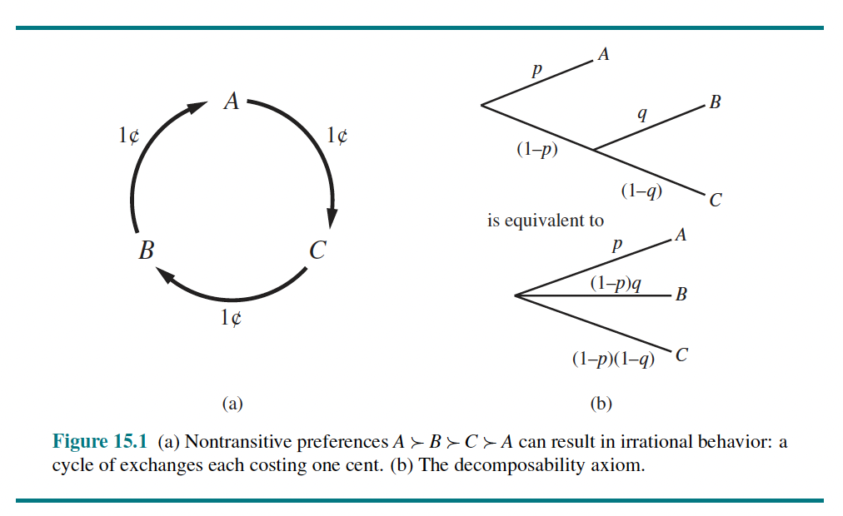
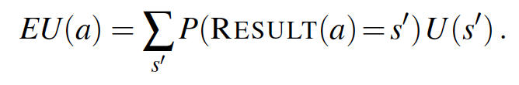
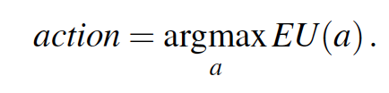
13.1 Sequential Decision Problems (1/7)
Utility & Expected utility
The utility function assigns a single number to express the desirability of a state
The expected utility of an action given the evidence, EU(a), is just the expected utility average utility value of the outcomes, weighted by the probability that the outcome occurs:
The maximum expected utility (MEU) : a rational agent should choose the action that maximizes the agent’s expected utility:
<출처> Stuart J. Russell and Peter Norvig (2021). Artificial Intelligence: A Modern Approach (4th Edition). Pearson
<출처> Stuart J. Russell and Peter Norvig (2021). Artificial Intelligence: A Modern Approach (4th Edition). Pearson

Slide 12
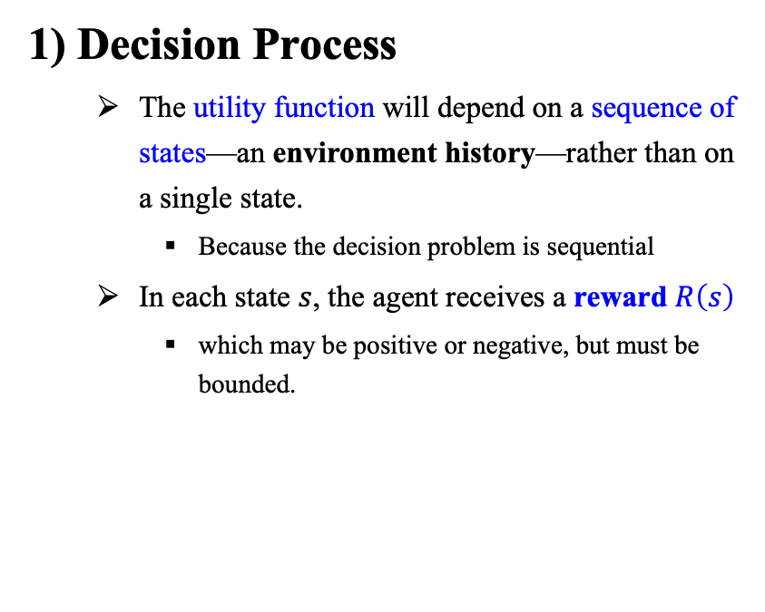
13.1 Sequential Decision Problems (2/7)
1) Decision Process
The utility function will depend on a sequence of states—an environment history—rather than on a single state.
Because the decision problem is sequential
In each state $s$, the agent receives a reward $R\left(s\right)$
which may be positive or negative, but must be bounded.
<출처> Stuart J. Russell and Peter Norvig (2021). Artificial Intelligence: A Modern Approach (4th Edition). Pearson

Slide 13
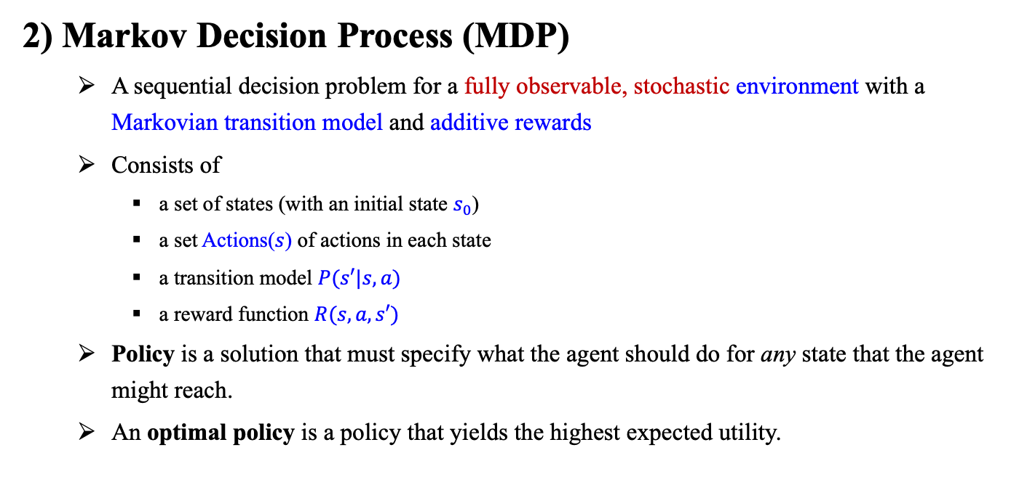
13.1 Sequential Decision Problems (3/7)
2) Markov Decision Process (MDP)
A sequential decision problem for a fully observable, stochastic environment with a Markovian transition model and additive rewards
Consists of
a set of states (with an initial state $s_{0}$)
a set Actions($s$) of actions in each state
a transition model $P(s′|s, a)$
a reward function $R(s,a,s′)$
Policy is a solution that must specify what the agent should do for any state that the agent might reach.
An optimal policy is a policy that yields the highest expected utility.

Slide 14
13.1 Sequential Decision Problems (4/7)
2) Markov Decision Process (MDP) contd.
<출처> Stuart J. Russell and Peter Norvig (2021). Artificial Intelligence: A Modern Approach (4th Edition). Pearson

Slide 15
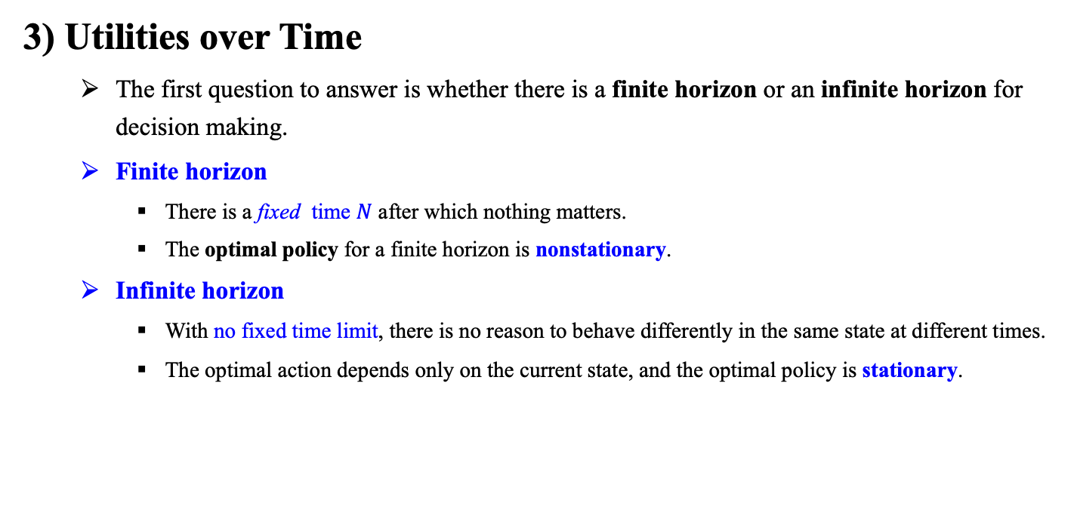
13.1 Sequential Decision Problems (5/7)
3) Utilities over Time
The first question to answer is whether there is a finite horizon or an infinite horizon for decision making.
Finite horizon
There is a fixed time $N$ after which nothing matters.
The optimal policy for a finite horizon is nonstationary.
Infinite horizon
With no fixed time limit, there is no reason to behave differently in the same state at different times.
The optimal action depends only on the current state, and the optimal policy is stationary.

Slide 16
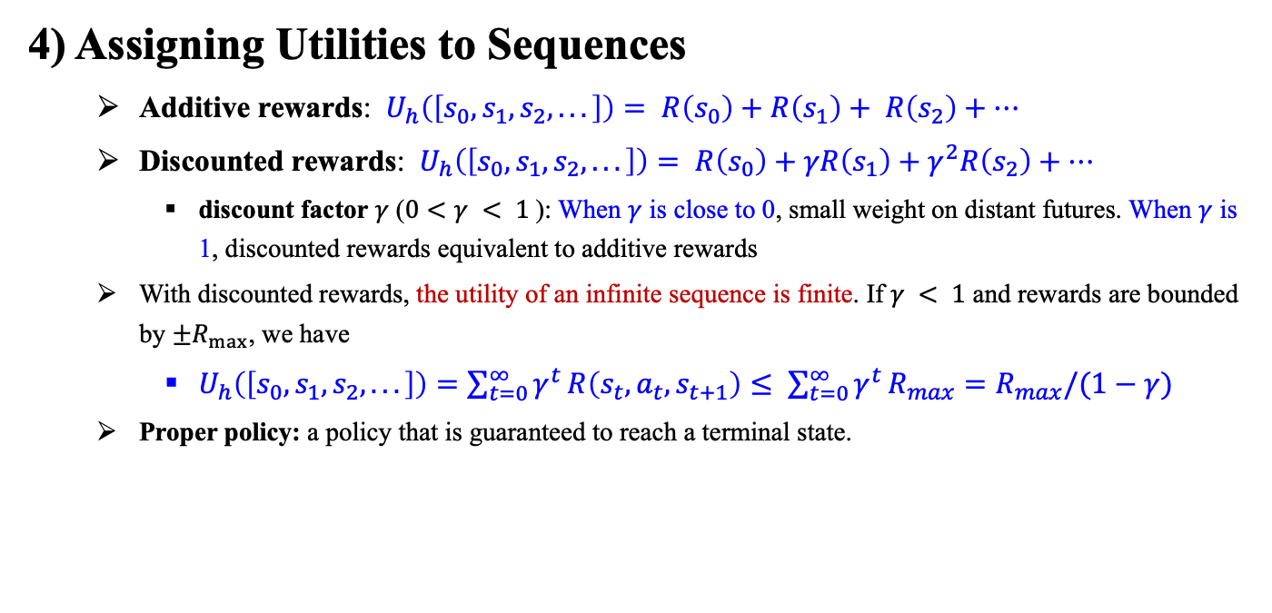
13.1 Sequential Decision Problems (6/7)
4) Assigning Utilities to Sequences
Additive rewards: $U_{h}\left(\left[s_{0}, s_{1}, s_{2}, . . .\right]\right)= R\left(s_{0}\right)+R\left(s_{1}\right)+ R\left(s_{2}\right)+…$
Discounted rewards: $U_{h}\left(\left[s_{0}, s_{1}, s_{2}, . . .\right]\right)= R\left(s_{0}\right)+γR\left(s_{1}\right)+γ^{2}R\left(s_{2}\right)+…$
discount factor $γ$ ($0<γ < 1$): When $γ$ is close to 0, small weight on distant futures. When $γ$ is 1, discounted rewards equivalent to additive rewards
With discounted rewards, the utility of an infinite sequence is finite. If $γ < 1$ and rewards are bounded by $±R_{max}$, we have
$U_{h}\left(\left[s_{0}, s_{1}, s_{2}, . . .\right]\right)=\sum_{t=0}^{∞}{γ^{t}}R\left(s_{t},a_{t},s_{t+1}\right)≤ \sum_{t=0}^{∞}{γ^{t}}R_{max}=R_{max}/(1−γ)$
Proper policy: a policy that is guaranteed to reach a terminal state.

Slide 17
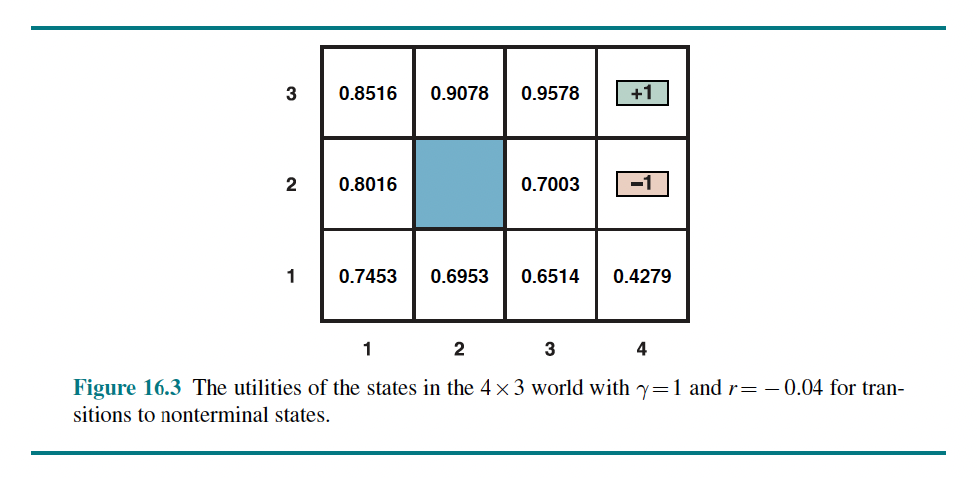
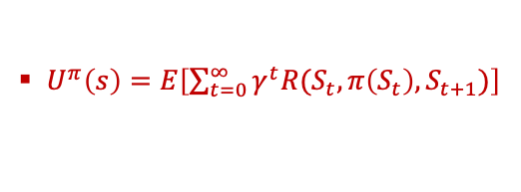
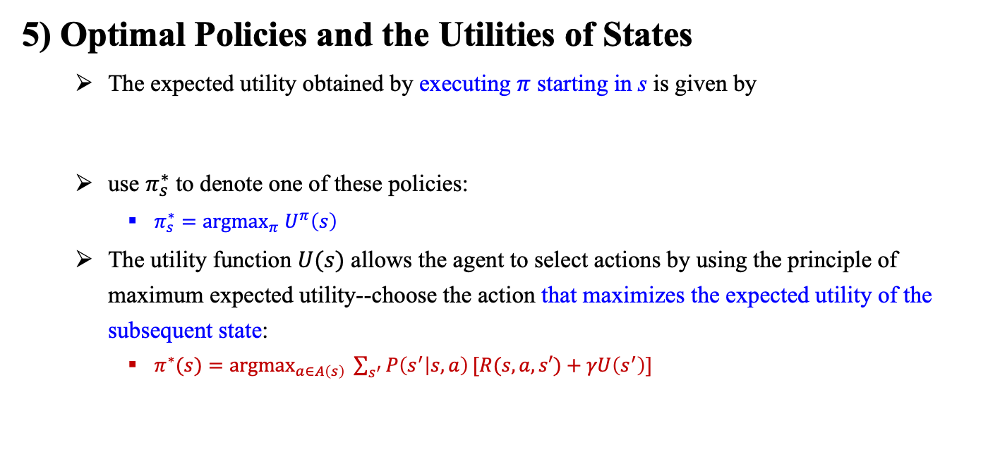
13.1 Sequential Decision Problems (7/7)
5) Optimal Policies and the Utilities of States
The expected utility obtained by executing $π$ starting in s is given by
use $π_{s}^{∗}$ to denote one of these policies:
$π_{s}^{∗}=\text{argma}{\text{x}}_{π} U^{π}\left(s\right)$
The utility function $U(s)$ allows the agent to select actions by using the principle of maximum expected utility--choose the action that maximizes the expected utility of the subsequent state:
$π^{∗}(s)=\text{argma}{\text{x}}_{a∈A\left(s\right)} \sum_{s^{′}}{P\left(s^{′} | s, a\right)}[R(s,a,s′)+γU\left(s^{′}\right)]$
$U^{π}\left(s\right)=E\left[\sum_{t=0}^{∞}{γ^{t}R(S_{t},π\left(S_{t}\right),S_{t+1})}\right]$
<출처> Stuart J. Russell and Peter Norvig (2021). Artificial Intelligence: A Modern Approach (4th Edition). Pearson

Slide 18
13.2 Algorithms for MDPs

Slide 19
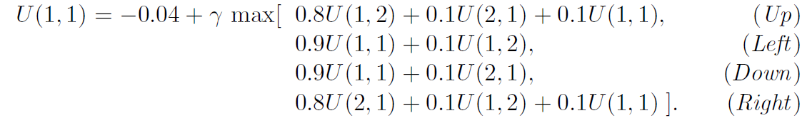
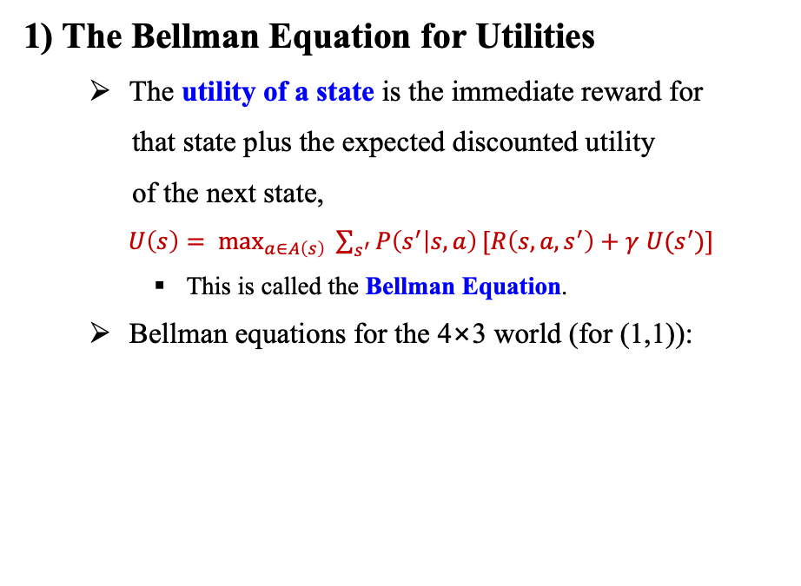
13.2 Algorithms for MDPs (1/11)
Value Iteration
1) The Bellman Equation for Utilities
The utility of a state is the immediate reward for
that state plus the expected discounted utility
of the next state,
$U\left(s\right)= \text{ma}{\text{x}}_{a∈A\left(s\right)} \sum_{s^{′}}{P\left(s^{′} | s, a\right)}[R\left(s,a,s^{′}\right)+$ $γ$ $U(s^{′})]$
This is called the Bellman Equation.
Bellman equations for the 4×3 world (for (1,1)):
<출처> Stuart J. Russell and Peter Norvig (2021). Artificial Intelligence: A Modern Approach (4th Edition). Pearson

Slide 20
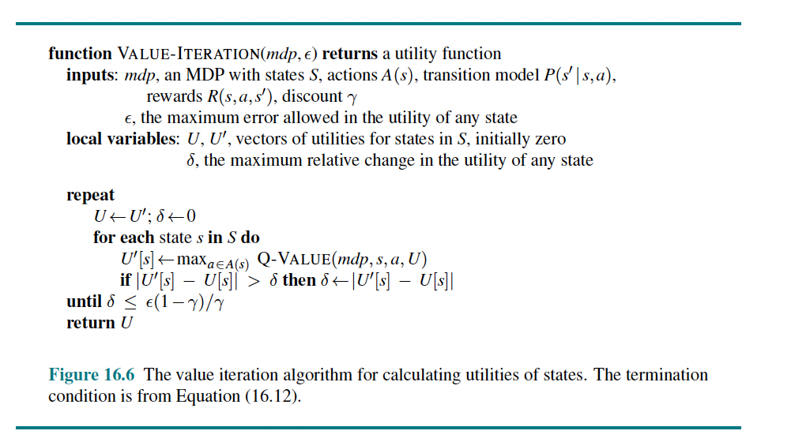
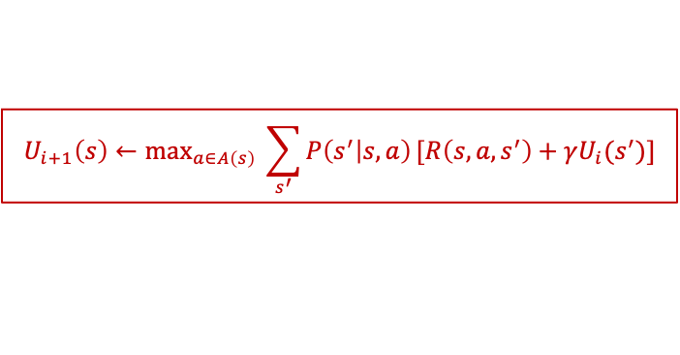
13.2 Algorithms for MDPs (2/11)
Value Iteration
2) The Value Iteration Algorithm
Bellman update
$$U_{i+1}\left(s\right)←\text{ma}{\text{x}}_{a∈A\left(s\right)} \sum_{s^{′}}{P\left(s^{′} | s, a\right)}[R\left(s,a,s^{′}\right)+γU_{i}(s^{′})]$$
<출처> Stuart J. Russell and Peter Norvig (2021). Artificial Intelligence: A Modern Approach (4th Edition). Pearson

Slide 21
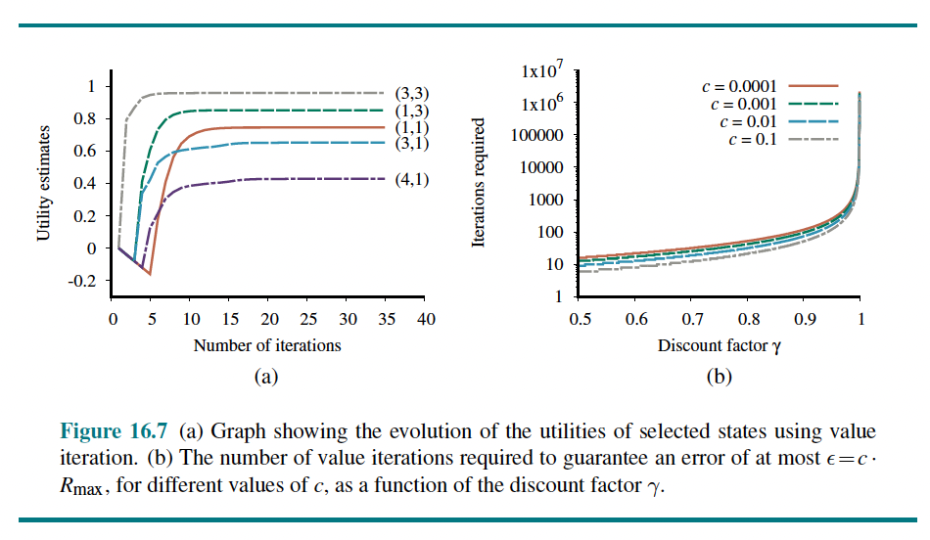
13.2 Algorithms for MDPs (3/11)
Value Iteration
2) The Value Iteration Algorithm (cont.)
<출처> Stuart J. Russell and Peter Norvig (2021). Artificial Intelligence: A Modern Approach (4th Edition). Pearson

Slide 22
13.2 Algorithms for MDPs (4/11)
Value Iteration
3) Convergence of Value Iteration (1/4)
The basic concept used in showing that value iteration converges is the notion of a contraction.
E.g the function “divide by two” is a contraction. This function has a fixed point, namely zero.
Two important properties of contractions:
A contraction has only one fixed point
When the function is applied to any argument, the value must get closer to the fixed point

Slide 23
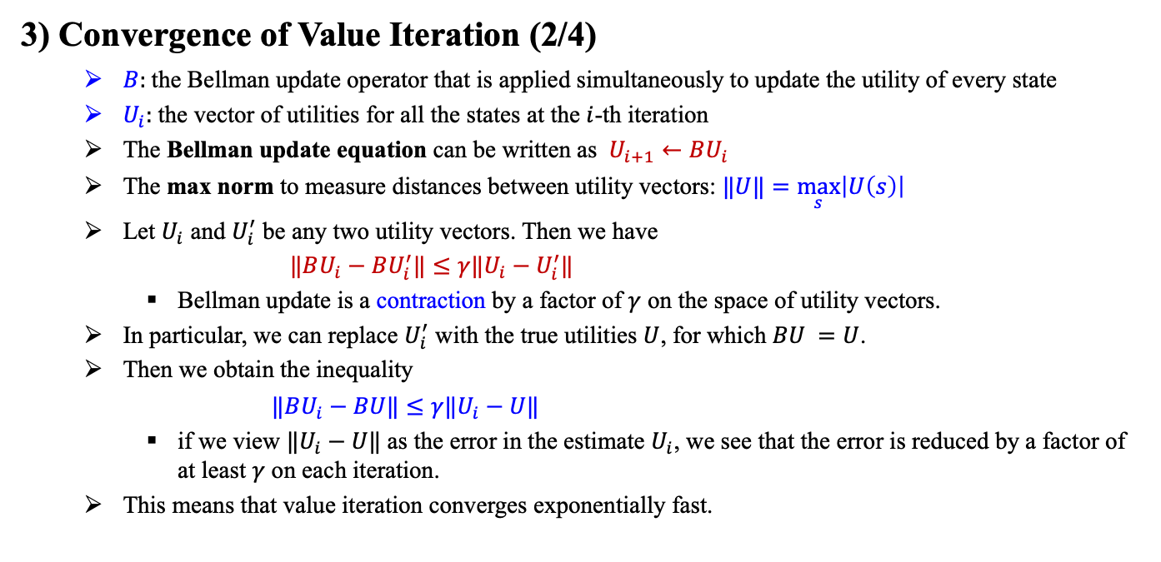
13.2 Algorithms for MDPs (5/11)
Value Iteration
3) Convergence of Value Iteration (2/4)
$B:$the Bellman update operator that is applied simultaneously to update the utility of every state
$U_{i}:$the vector of utilities for all the states at the $i$-th iteration
The Bellman update equation can be written as $U_{i+1}←BU_{i}$
The max norm to measure distances between utility vectors: $‖U‖=\max_{s}\left|U\left(s\right)\right|$
Let $U_{i}$ and $U_{i}^{′}$ be any two utility vectors. Then we have
$‖BU_{i}−BU_{i}^{′}‖≤γ‖U_{i}−U_{i}^{′}‖$
Bellman update is a contraction by a factor of $γ$ on the space of utility vectors.
In particular, we can replace $U_{i}^{′}$ with the true utilities $U$, for which $BU =U$.
Then we obtain the inequality
$‖BU_{i}−BU‖≤γ‖U_{i}−U‖$
if we view $‖U_{i}−U‖$ as the error in the estimate $U_{i}$, we see that the error is reduced by a factor of at least $γ$ on each iteration.
This means that value iteration converges exponentially fast.

Slide 24
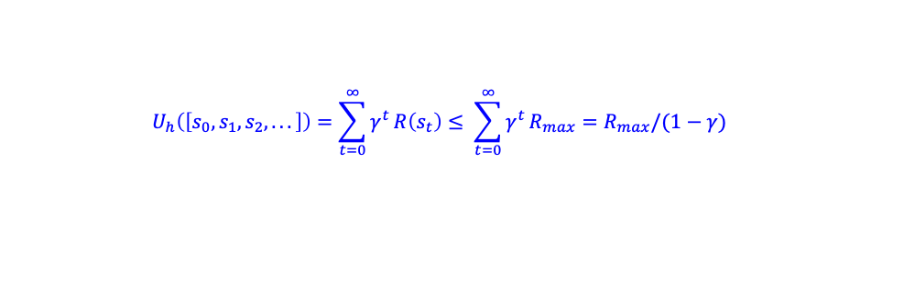
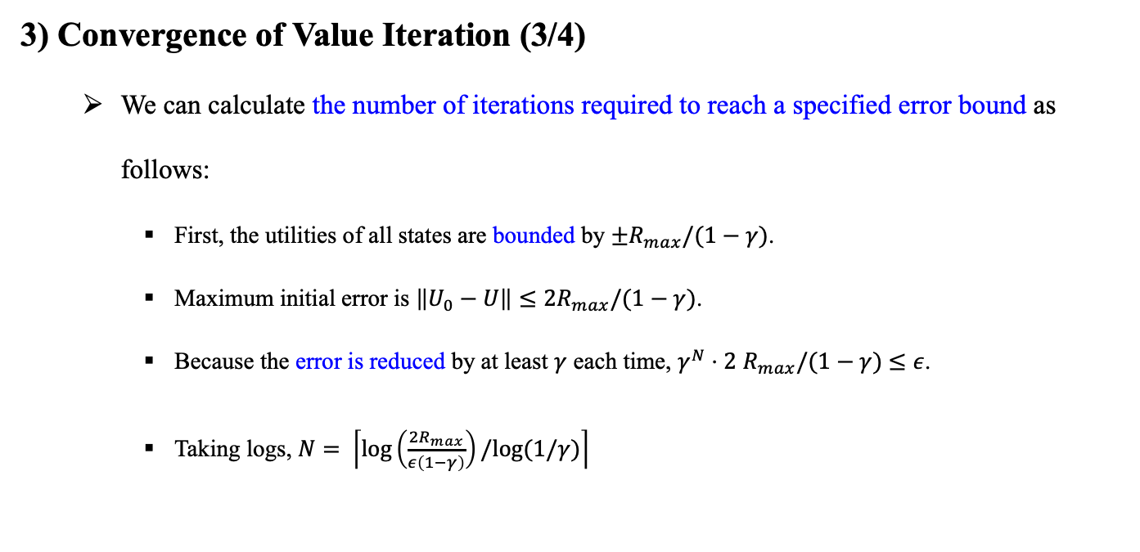
13.2 Algorithms for MDPs (6/11)
Value Iteration
3) Convergence of Value Iteration (3/4)
We can calculate the number of iterations required to reach a specified error bound as follows:
First, the utilities of all states are bounded by ${±R}_{max}/(1−γ)$.
Maximum initial error is ${\left\|U_{0}−U\right\|≤2R}_{max}/(1−γ)$.
Because the error is reduced by at least $γ$ each time, $γ^{N}⋅2$ $R_{max}/(1−γ)$ $≤ε$.
Taking logs, $N= \left\lceil \log\left(\frac{{2R}_{max}}{ε\left(1−γ\right)}\right)/log⁡(1/γ)\right\rceil$
$$U_{h}\left(\left[s_{0}, s_{1}, s_{2}, . . .\right]\right)=\sum_{t=0}^{∞}{γ^{t}}R\left(s_{t}\right)≤ \sum_{t=0}^{∞}{γ^{t}}R_{max}=R_{max}/(1−γ)$$

Slide 25
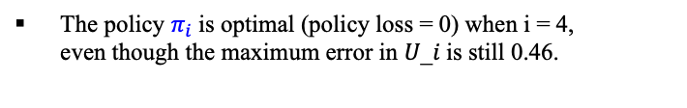
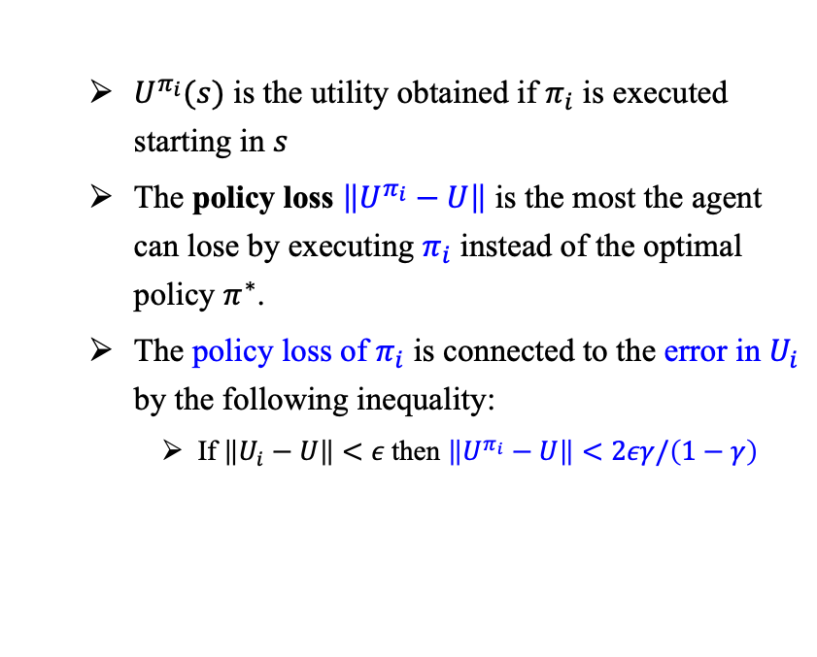
13.2 Algorithms for MDPs (7/11)
Value Iteration
3) Convergence of Value Iteration (4/4)
$U^{π_{i}}(s)$ is the utility obtained if $π_{i}$ is executed starting in $s$
The policy loss $\left\|U^{π_{i}}−U\right\|$ is the most the agent can lose by executing $π_{i}$ instead of the optimal policy $π^{∗}$.
The policy loss of $π_{i}$ is connected to the error in $U_{i}$ by the following inequality:
If $\left\|U_{i}−U\right\|<ε$then $\left\|U^{π_{i}}−U\right\|<2εγ/\left(1−γ\right)$
The policy $π_{i}$is optimal (policy loss = 0) when i = 4, even though the maximum error in 𝑈_𝑖 is still 0.46.
<출처> Stuart J. Russell and Peter Norvig (2021). Artificial Intelligence: A Modern Approach (4th Edition). Pearson

Slide 26
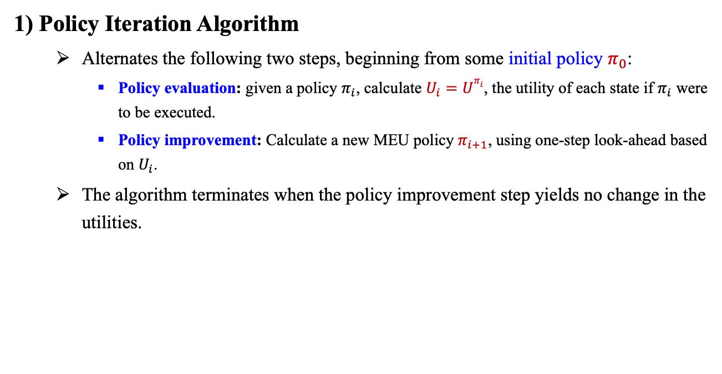
13.2 Algorithms for MDPs (8/11)
Policy Iteration
1) Policy Iteration Algorithm
Alternates the following two steps, beginning from some initial policy $π_{0}$:
Policy evaluation: given a policy $π_{i}$, calculate $U_{i}=Uπ_{i}$, the utility of each state if $π_{i}$ were to be executed.
Policy improvement: Calculate a new MEU policy $π_{i+1}$, using one-step look-ahead based on $U_{i}$.
The algorithm terminates when the policy improvement step yields no change in the utilities.

Slide 27
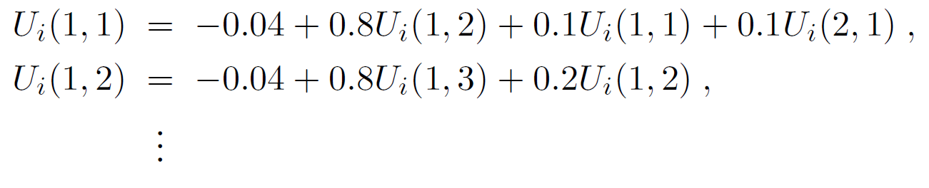
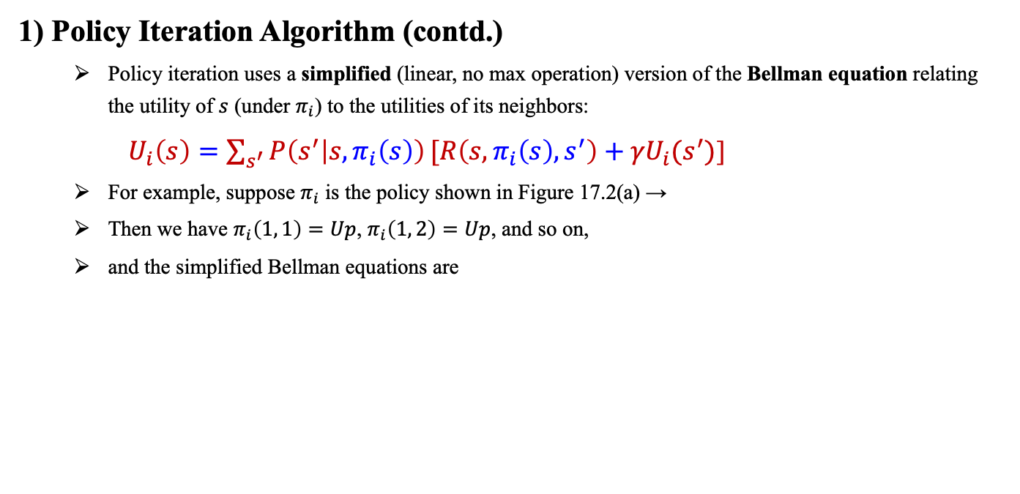
13.2 Algorithms for MDPs (9/11)
Policy Iteration
1) Policy Iteration Algorithm (contd.)
Policy iteration uses a simplified (linear, no max operation) version of the Bellman equation relating the utility of $s$ (under $π_{i}$) to the utilities of its neighbors:
$U_{i}\left(s\right)=\sum_{s^{′}}{P\left(s^{′} | s, π_{i}\left(s\right)\right)}{[R\left(s,π_{i}\left(s\right), s^{′}\right)+γU}_{i}(s^{′})$]
For example, suppose $π_{i}$ is the policy shown in Figure 17.2(a) →
Then we have $π_{i}\left(1, 1\right)=Up$, $π_{i}\left(1, 2\right)=Up$, and so on,
and the simplified Bellman equations are
<출처> Stuart J. Russell and Peter Norvig (2021). Artificial Intelligence: A Modern Approach (4th Edition). Pearson

Slide 28
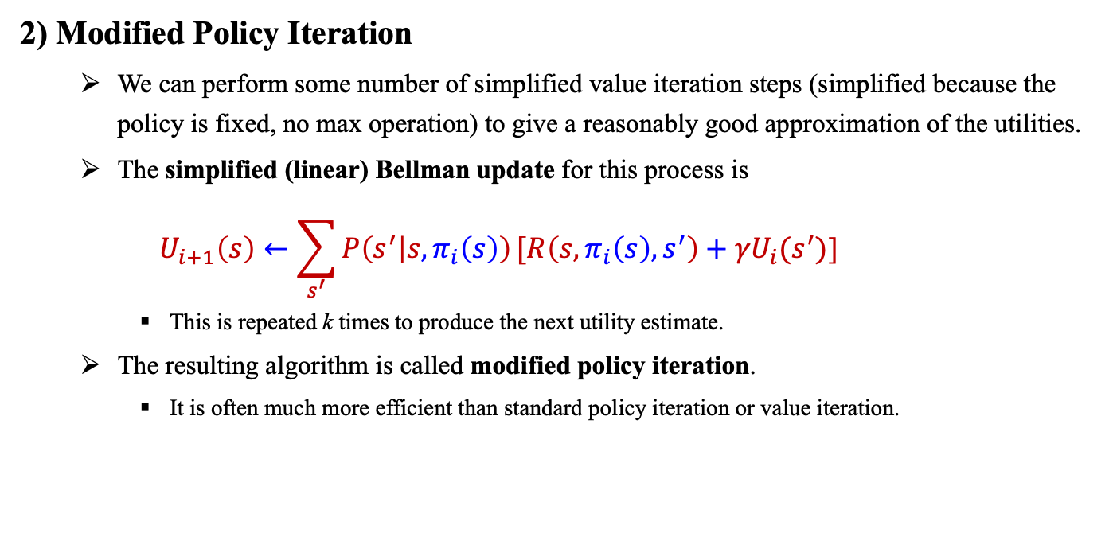
13.2 Algorithms for MDPs (10/11)
Policy Iteration
2) Modified Policy Iteration
We can perform some number of simplified value iteration steps (simplified because the policy is fixed, no max operation) to give a reasonably good approximation of the utilities.
The simplified (linear) Bellman update for this process is
$$U_{i+1}\left(s\right)←\sum_{s^{′}}{P\left(s^{′} | s, π_{i}\left(s\right)\right)}{[R\left(s,π_{i}\left(s\right), s^{′}\right)+γU}_{i}(s^{′})\text{]}$$
This is repeated k times to produce the next utility estimate.
The resulting algorithm is called modified policy iteration.
It is often much more efficient than standard policy iteration or value iteration.

Slide 29
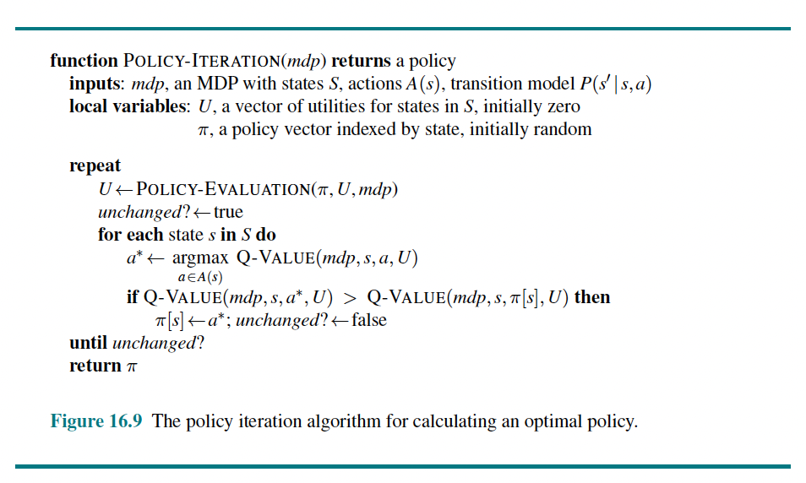
13.2 Algorithms for MDPs (11/11)
Policy Iteration
2) Modified Policy Iteration
Updating the utility or policy(policy improvement or simplified value iteration)
for all states at once
pick any subset of states
(asynchronous policy iteration)
<출처> Stuart J. Russell and Peter Norvig (2021). Artificial Intelligence: A Modern Approach (4th Edition). Pearson

Slide 30
13.3 Partially Observable MDPs

Slide 31
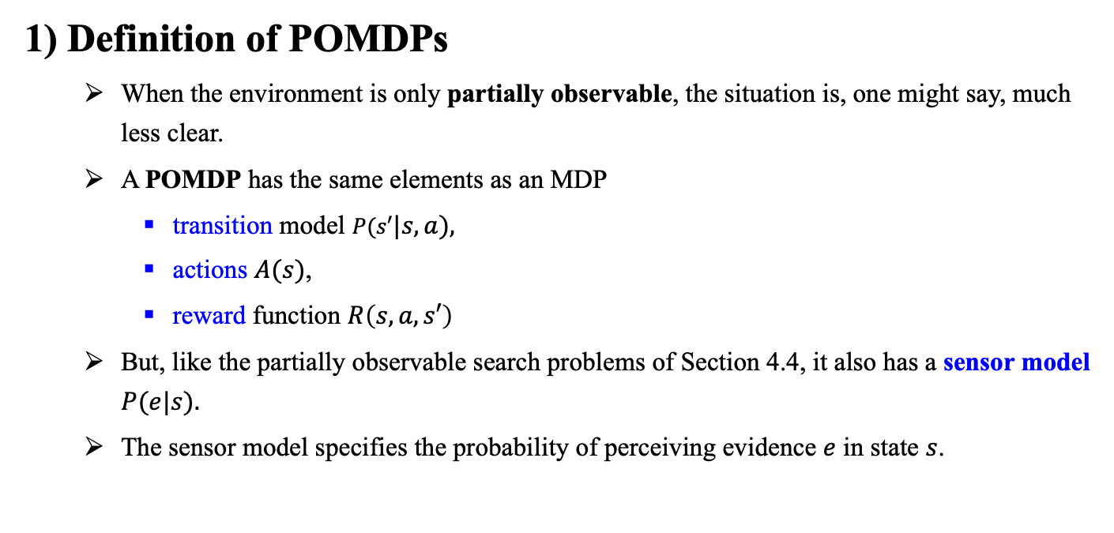
13.3 Partially Observable MDPs (1/5)
1) Definition of POMDPs
When the environment is only partially observable, the situation is, one might say, much less clear.
A POMDP has the same elements as an MDP
transition model $P(s′|s, a),$
actions $A(s)$,
reward function $R\left(s,a,s′\right)$
But, like the partially observable search problems of Section 4.4, it also has a sensor model $P(e|s).$
The sensor model specifies the probability of perceiving evidence $e$ in state $s$.

Slide 32
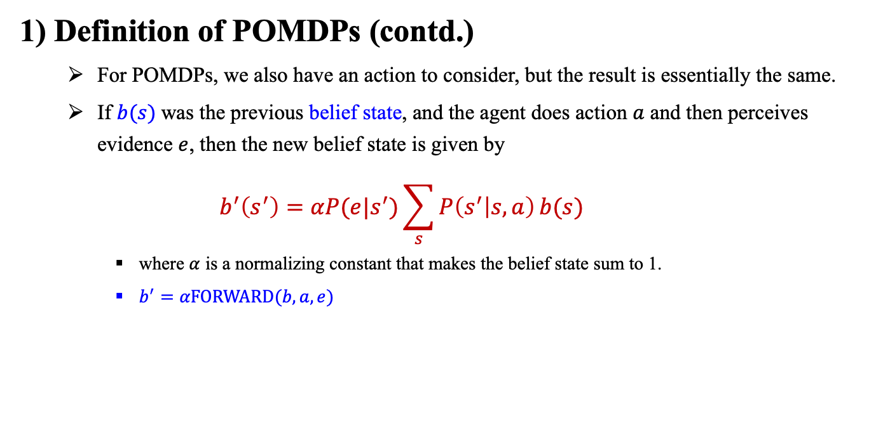
13.3 Partially Observable MDPs (2/5)
1) Definition of POMDPs (contd.)
For POMDPs, we also have an action to consider, but the result is essentially the same.
If $b(s)$was the previous belief state, and the agent does action $a$ and then perceives evidence $e$, then the new belief state is given by
$$b^{′}\left(s^{′}\right)=αP(e|s^{′})\sum_{s}{P\left(s^{′} | s, a\right)}b(s)$$
where $α$ is a normalizing constant that makes the belief state sum to 1.
$b^{′}=α\text{FORWARD}(b, a, e)$

Slide 33
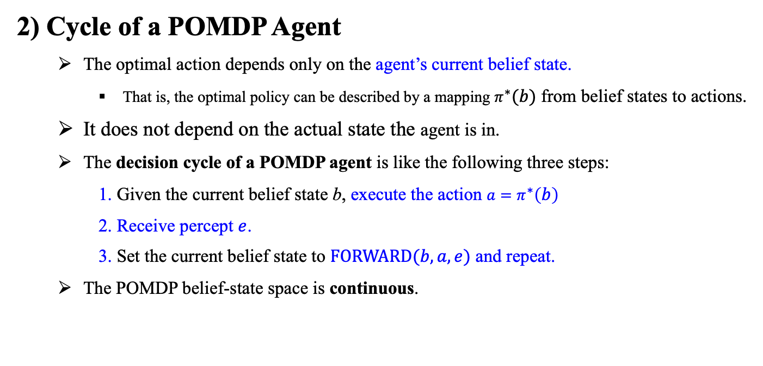
13.3 Partially Observable MDPs (3/5)
2) Cycle of a POMDP Agent
The optimal action depends only on the agent’s current belief state.
That is, the optimal policy can be described by a mapping $π^{∗}(b)$ from belief states to actions.
It does not depend on the actual state the agent is in.
The decision cycle of a POMDP agent is like the following three steps:
1. Given the current belief state b, execute the action $a=π^{∗}\left(b\right)$
2. Receive percept $e$.
3. Set the current belief state to $\text{FORWARD}(b, a, e)$ and repeat.
The POMDP belief-state space is continuous.

Slide 34
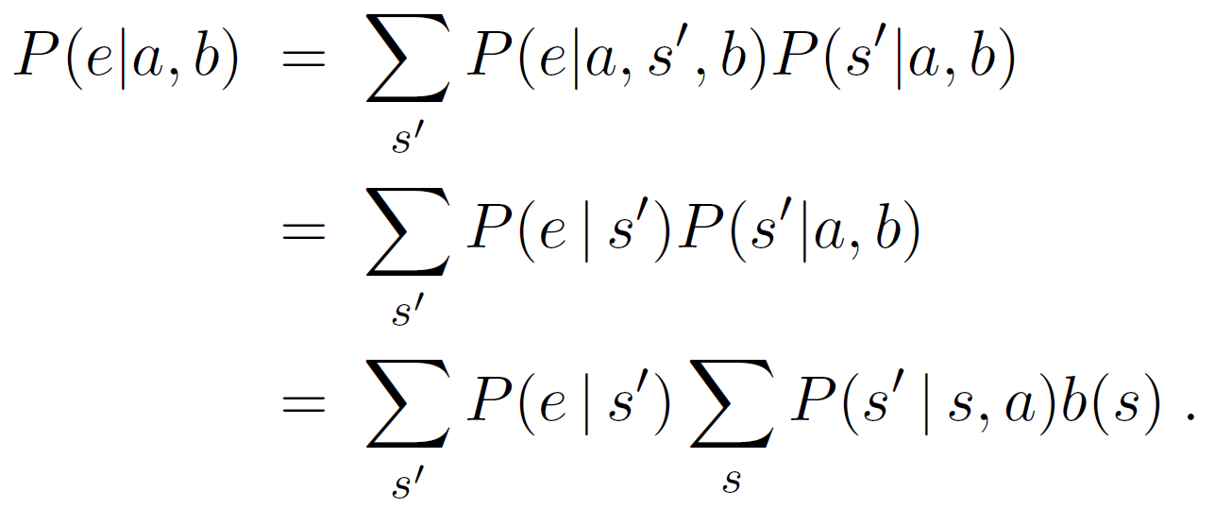
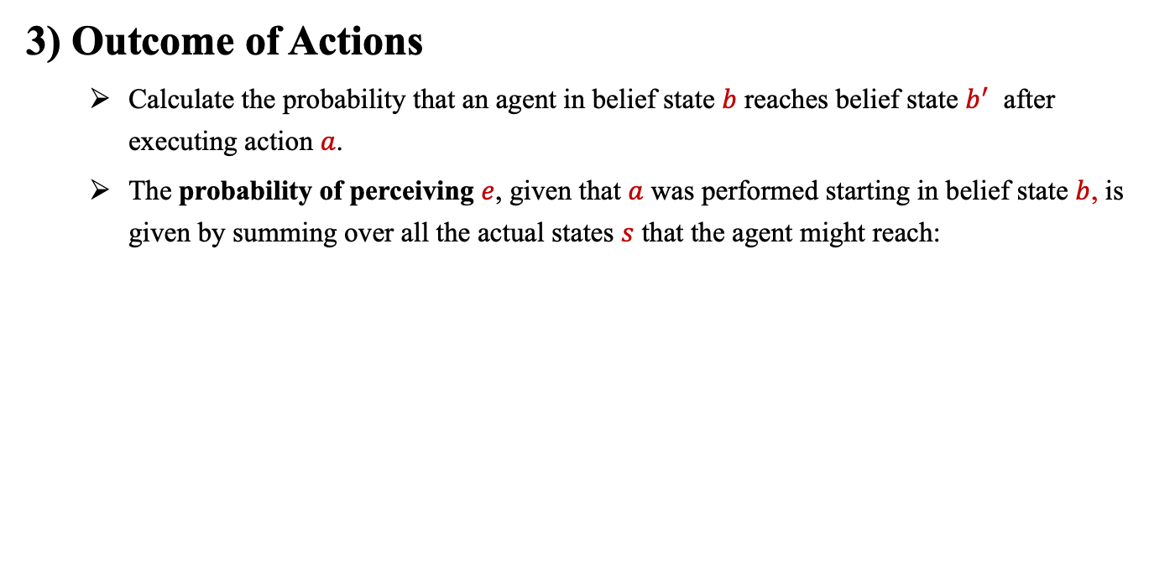
13.3 Partially Observable MDPs (4/5)
3) Outcome of Actions
Calculate the probability that an agent in belief state $b$ reaches belief state $b^{′}$ after executing action $a$.
The probability of perceiving $e$, given that $a$ was performed starting in belief state $b$, is given by summing over all the actual states $s$ that the agent might reach:

Slide 35
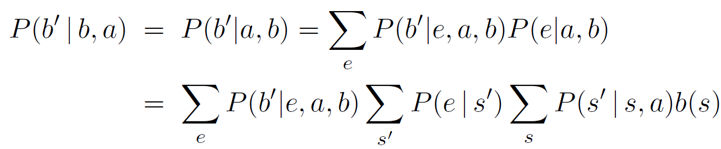
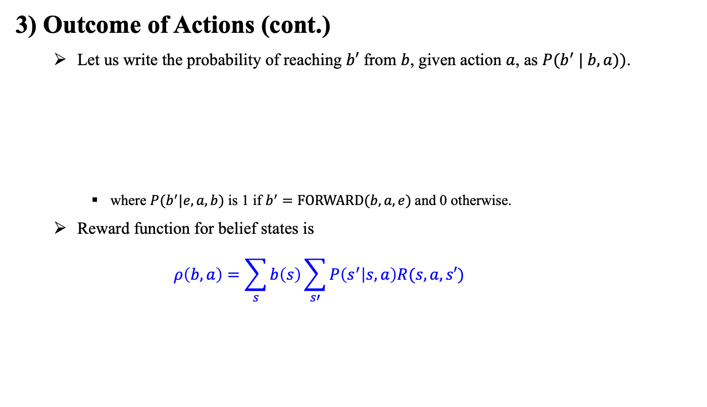
13.3 Partially Observable MDPs (5/5)
3) Outcome of Actions (cont.)
Let us write the probability of reaching $b′$ from $b$, given action $a$, as $P(b^{′} | b, a))$.
where $P(b^{′}|e, a, b)$ is 1 if $b^{′}=\text{FORWARD}(b, a, e)$and 0 otherwise.
Reward function for belief states is
$$ρ\left(b,a\right)=\sum_{s}{b\left(s\right)}\sum_{s′}{P\left(s^{′} | s,a\right)R(s,a,s′)}$$

Slide 36
13.4 Algorithms for Solving POMDPs

Slide 37
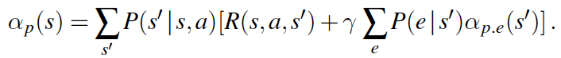
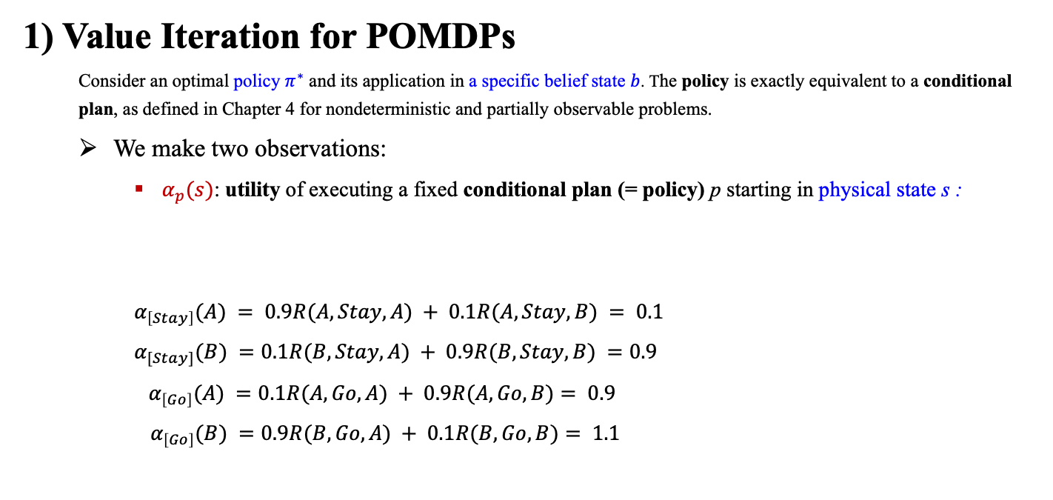
13.4 Algorithms for Solving POMDPs (1/5)
1) Value Iteration for POMDPs
Consider an optimal policy $π^{∗}$ and its application in a specific belief state $b$. The policy is exactly equivalent to a conditional plan, as defined in Chapter 4 for nondeterministic and partially observable problems.
We make two observations:
$α_{p}(s)$: utility of executing a fixed conditional plan (= policy) p starting in physical state s :
$α_{\left[Stay\right]}(A) = 0.9R(A,Stay,A) + 0.1R(A, Stay, B) = 0.1$
$α_{[Stay]}(B) =0.1R(B,Stay,A) + 0.9R(B, Stay, B) =0.9$
${ α}_{\left[Go\right]}(A) =0.1R(A,Go,A) + 0.9R(A, Go, B)= 0.9$
$α_{\left[Go\right]}(B) =0.9R(B,Go,A) + 0.1R(B, Go, B)= 1.1$

Slide 38
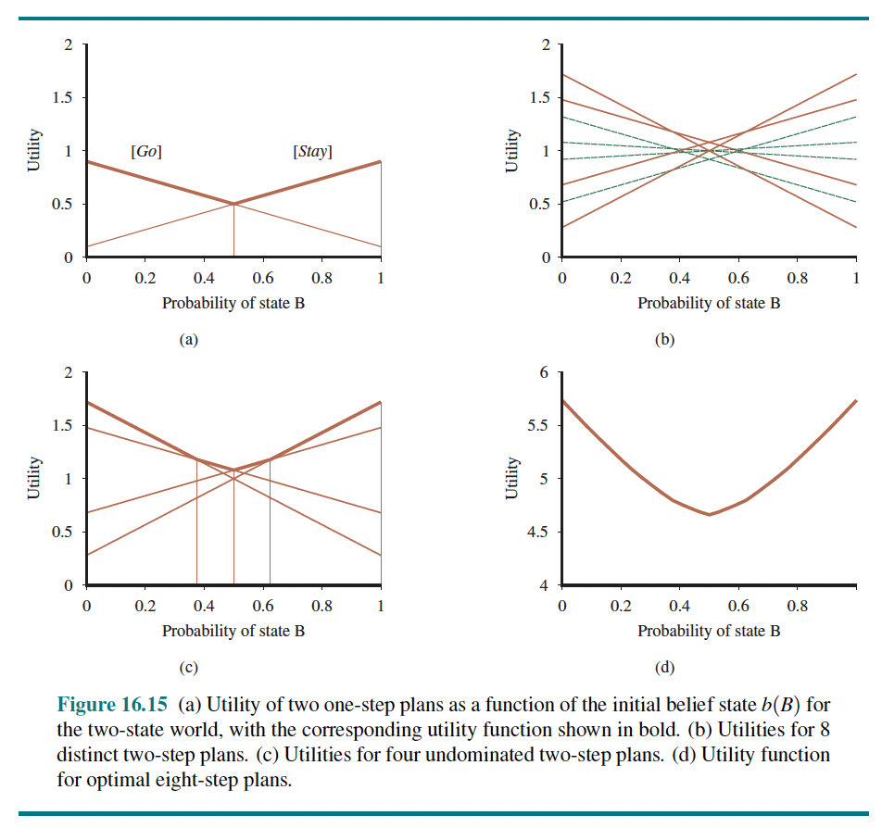
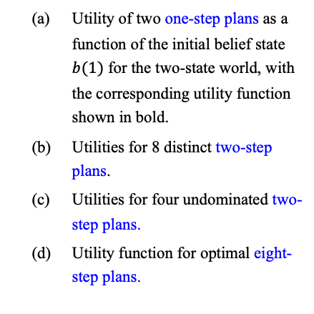
13.4 Algorithms for Solving POMDPs (2/5)
Undominated plans
Hyperplane
Piecewise linear
Convex
Utility of two one-step plans as a function of the initial belief state $b(1)$ for the two-state world, with the corresponding utility function shown in bold.
Utilities for 8 distinct two-step plans.
Utilities for four undominated two-step plans.
Utility function for optimal eight-step plans.
<출처> Stuart J. Russell and Peter Norvig (2021). Artificial Intelligence: A Modern Approach (4th Edition). Pearson

Slide 39
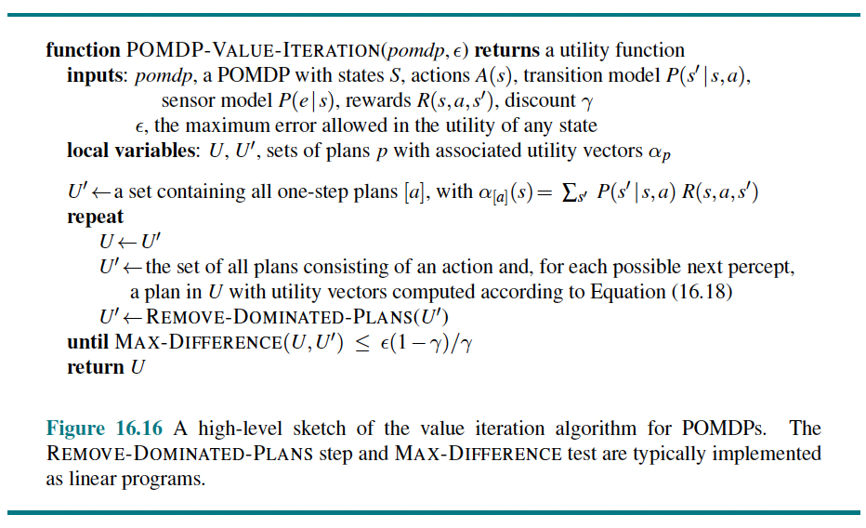
13.4 Algorithms for Solving POMDPs (3/5)
4) Value Iteration for POMDPs
<출처> Stuart J. Russell and Peter Norvig (2021). Artificial Intelligence: A Modern Approach (4th Edition). Pearson

Slide 40
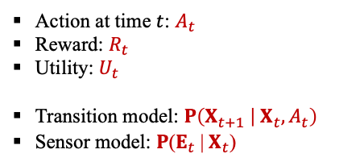
13.4 Algorithms for Solving POMDPs (4/5)
5) Online Agents for POMDPs
The basic elements of the agent design for partially observable, stochastic environments:
The transition and sensor models are represented by a dynamic Bayesian network (DBN) (Chapter 15).
The dynamic Bayesian network is extended with decision and utility nodes, as used in decision networks in Chapter 16. The resulting model is called a dynamic decision network, or DDN.
A filtering algorithm is used to incorporate each new percept and action and to update the belief state representation.
Decisions are made by projecting forward possible action sequences and choosing the best one.
Action at time $t$: $A_{t}$
Reward: $R_{t}$
Utility: $U_{t}$
Transition model: $P\left(X_{t+1} | { X}_{t},A_{t}\right)$
Sensor model: $P\text{(}E_{t} \text{|}{ X}_{t}\text{)}$
<출처> Stuart J. Russell and Peter Norvig (2021). Artificial Intelligence: A Modern Approach (4th Edition). Pearson

Slide 41
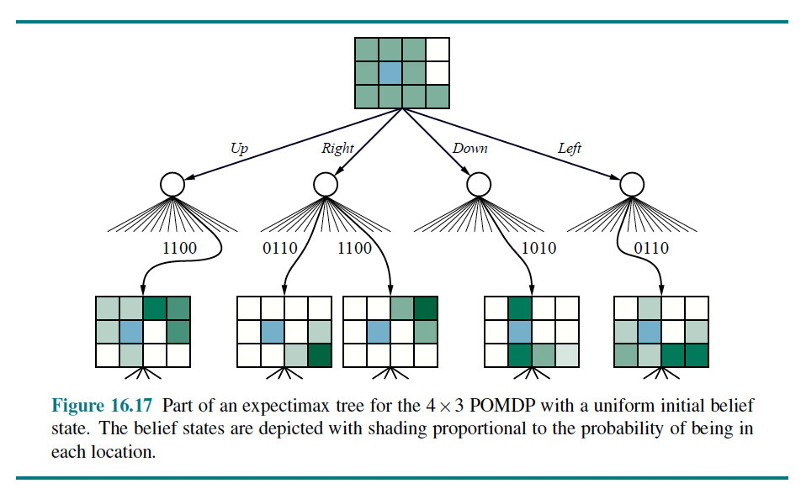
13.4 Algorithms for Solving POMDPs (5/5)
5) Online Algorithms for POMDPs
<출처> Stuart J. Russell and Peter Norvig (2021). Artificial Intelligence: A Modern Approach (4th Edition). Pearson

Slide 42
Summary
Sequential decision problems in uncertain environments, also called Markov decision processes, or MDPs, are defined by a transition model specifying the probabilistic outcomes of actions and a reward function specifying the reward in each state.
The solution of an MDP is a policy that associates a decision with every state that the agent might reach. An optimal policy maximizes the utility of the state sequences encountered when it is executed.
The value iteration algorithm for solving MDPs works by iteratively solving the equations relating the utility of each state to those of its neighbors.
Policy iteration alternates between calculating the utilities of states under the current policy and improving the current policy with respect to the current utilities.
A decision-theoretic agent can be constructed for POMDP environments. The agent uses a dynamic decision network to represent the transition and sensor models, to update its belief state, and to project forward possible action sequences.

